Slide 1

NutriAI – AI-Enhanced Personal Nutrition & Activity Assistant
AI Applied Project
Team: Aashish Giri, Jaykesh J Awal, Meet Patel, Sabin Khatri
Date: July 10, 2025

Slide 2



Project Overview
NutriAI is an intelligent assistant engineered to empower users in achieving their daily health objectives. It provides real-time, personalized dietary and activity recommendations based on individual needs and progress, fostering a holistic approach to well-being.
Personalized Nutrition
Activity Recommendations
Intelligent Assistance
Tailored meal plans and dietary advice.
AI-driven insights for optimal health.
Customized exercise routines and fitness goals.

Slide 3

Core Objectives
1
2
Predict Goal Attainment
Personalized Suggestions
Accurately predict if users will meet their daily nutritional and activity goals based on logged data.
Generate tailored recommendations for food and exercise to help users stay on track.
3
4
Explainable & Ethical AI
Synthetic Data & Personas
Develop transparent AI models that explain their recommendations and adhere to ethical guidelines.
Utilize synthetic data and diverse personas for robust model training and validation.

Slide 4

Dataset & Synthetic Personas
Our project leverages a comprehensive Kaggle nutrition dataset as its foundational data source. To ensure ethical AI development and safeguard privacy, we created 8 distinct synthetic user personas, each with a unique set of dietary and activity patterns. For each persona, we generated 7 days of detailed logs, capturing their daily food intake and physical activities. The primary target variable for our models is a binary indicator: whether the user's nutritional goals were met or not.

Slide 5
Data Cleaning & Preparation
Standardize Units
Handle Missing Values
Converted all nutritional values to consistent units (grams, milliliters) for uniformity.
Implemented robust imputation strategies to address any gaps in the raw dataset.
Validate Nutritional Totals
Remove Invalid Entries
Cross-checked aggregated nutritional values against individual component sums for accuracy.
Identified and purged erroneous or illogical data points to maintain data integrity.

Slide 6
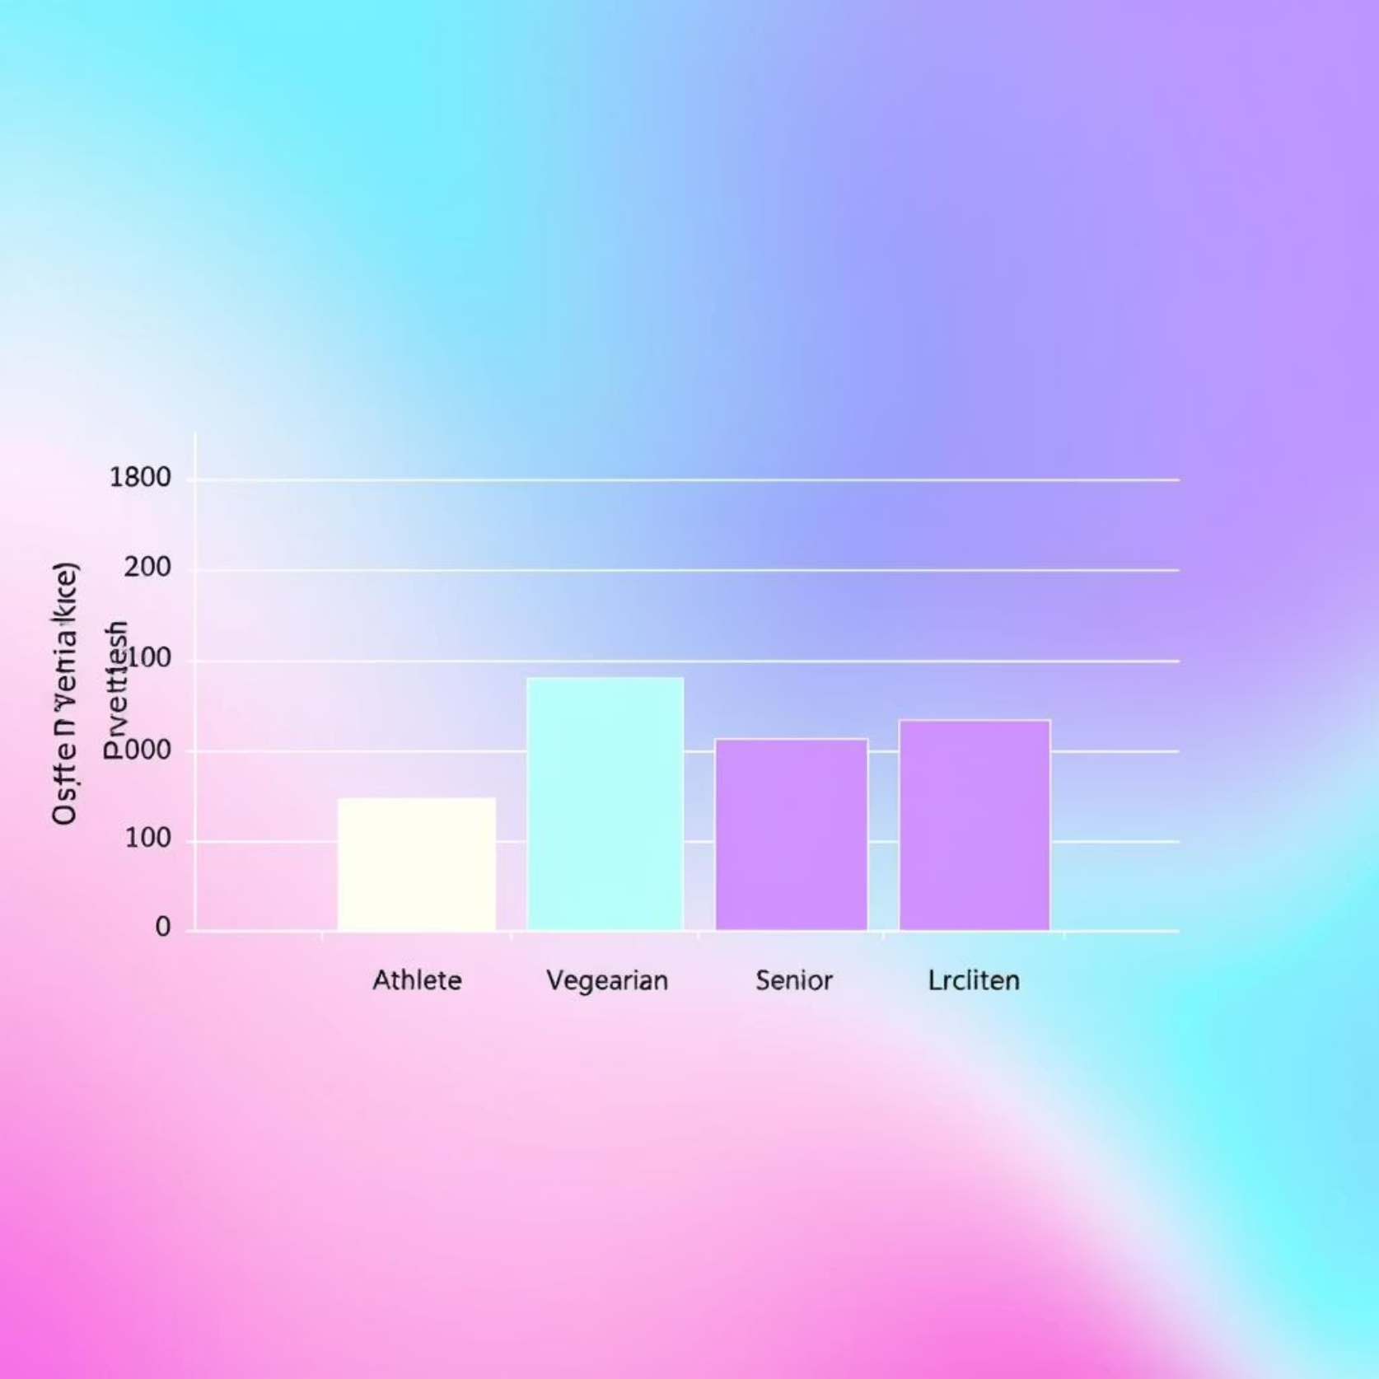
Exploratory Data Analysis (EDA) Example
An illustrative example of our EDA is the boxplot of daily protein intake by persona. This visualization clearly shows that the muscle gain persona exhibits the highest median protein intake, aligning with their specific health goals. This analysis helped us validate the diversity and distinct characteristics of our synthetic personas, confirming their realistic representation within the dataset.

Slide 7




System Architecture
Data Foundation
Model
Curated and preprocessed datasets.
Machine learning models for predictions.
Rule Engine
User Interface
Business logic and recommendation generation.
Interactive dashboard for user interaction.
The entire system is developed using Google Colab with Python and the Streamlit framework for the user interface. We utilize a saved model with integrated logic for seamless operation.

Slide 8
Data Pipeline Flow
1
2
Curate Base Food Dataset
Generate User-Day Logs
Establish a comprehensive foundation of food items and their nutritional values.
Create realistic daily activity and food consumption logs for each synthetic persona.
3
4
Apply SMOTE for Balance
Train/Test ML Models
Utilize Synthetic Minority Over-sampling Technique (SMOTE) to address class imbalance in the target variable.
Split the balanced dataset for training and rigorous testing of machine learning models.

Slide 9

Synthetic Data Generation
The use of synthetic data is a cornerstone of NutriAI's ethical and practical development. By generating artificial data, we entirely avoid privacy concerns associated with handling real user information. Each row in our dataset represents a single day of activity for a specific persona, including their dietary intake and physical exertion. This approach allows us to create a diverse and realistic dataset, enabling the training of robust models that can make highly accurate predictions without compromising user confidentiality.

Slide 10
Model Selection & Training
Our model selection process began with a Logistic Regression as a baseline, providing a solid initial benchmark for performance. After extensive experimentation and evaluation, we selected Random Forest as our final machine learning model due to its superior predictive accuracy and ability to handle complex relationships within our dataset.
The Random Forest model was meticulously trained with 100 decision trees, and a maximum depth of 6 for each tree. This configuration was chosen to optimize the balance between model complexity and generalization, preventing overfitting while maintaining high predictive power.

Slide 11
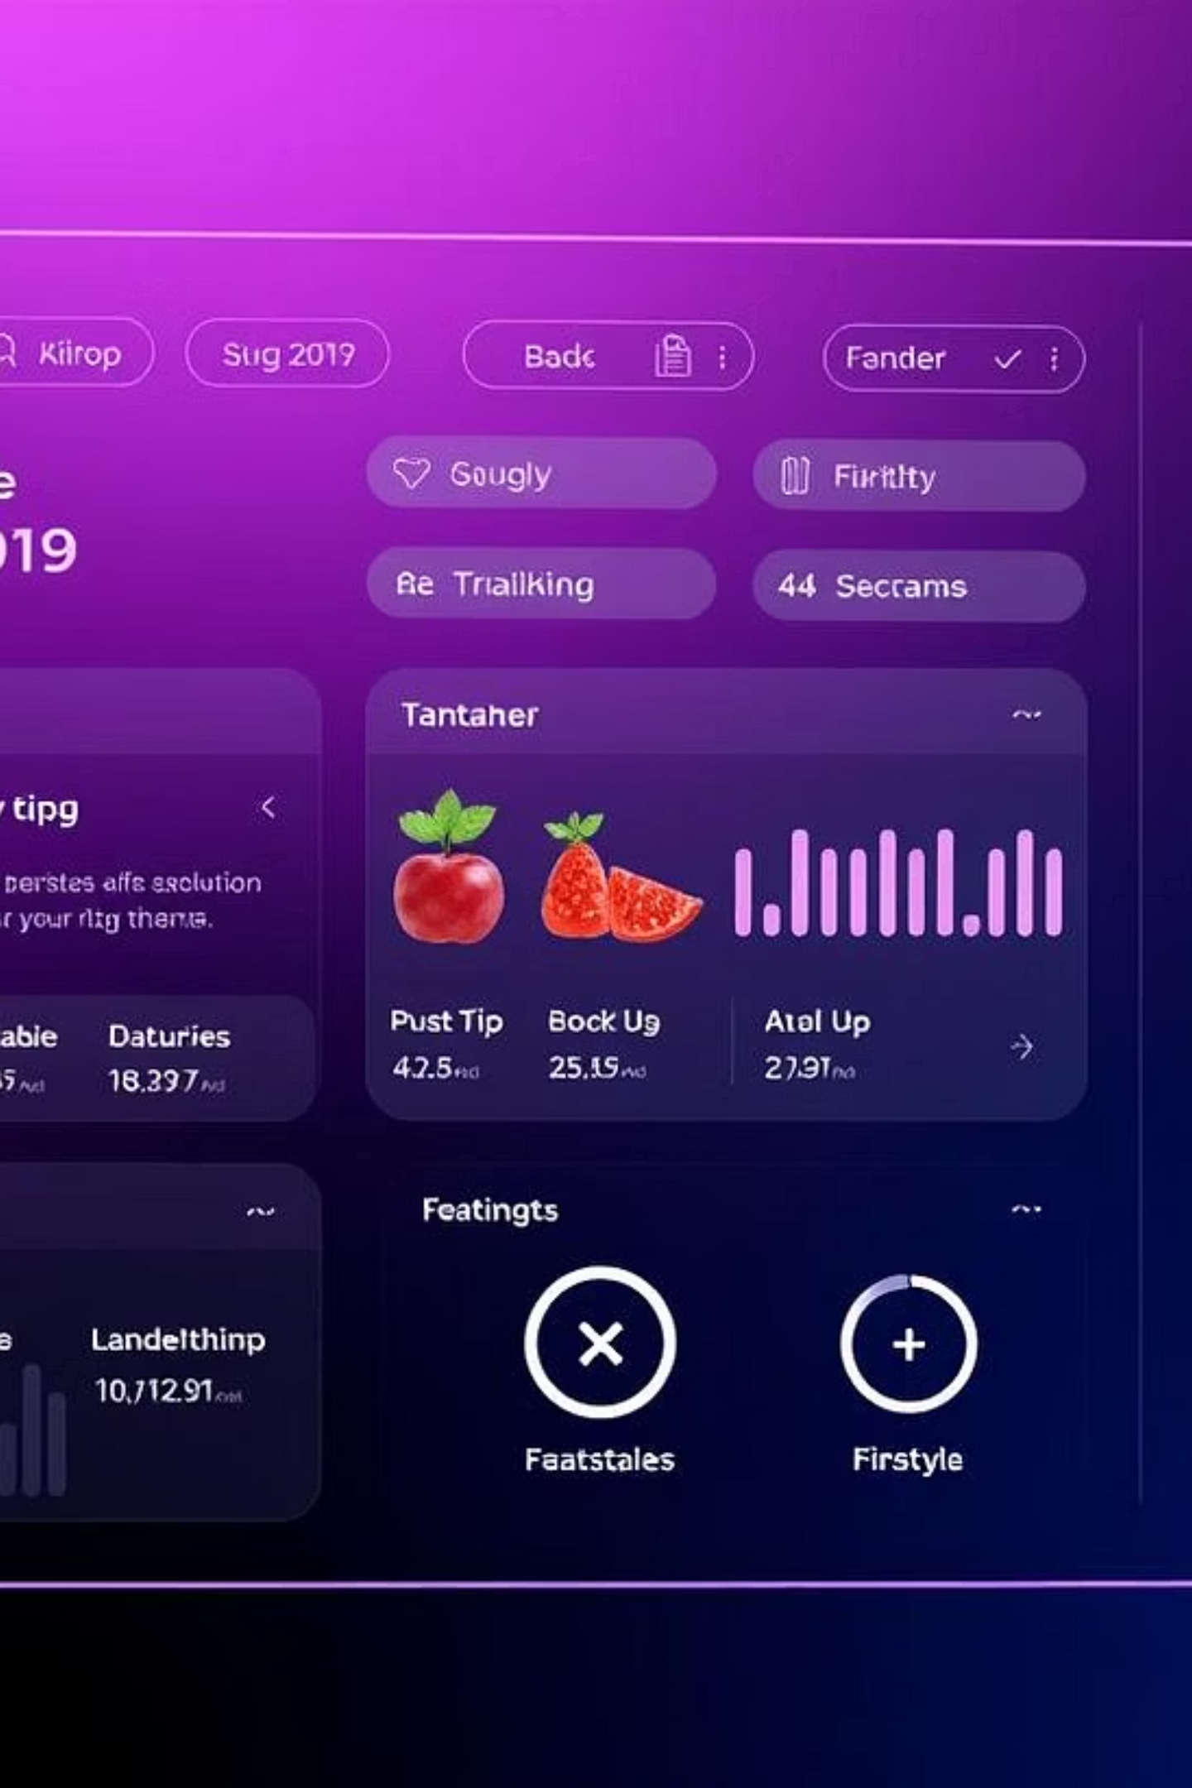
NutriAI: Smart Nutritional Guidance
Empowering users with personalized, AI-driven dietary advice.

Slide 12



Addressing Data Imbalance with SMOTE
Original Data State
SMOTE Implementation
Performance Impact
Class 0 (goal not met) was significantly dominant in the dataset.
Synthetically generated samples for the under-represented class (goal_met = 1) to achieve balance.
Improved the F1-score from 0.63 to 0.73, indicating better model generalization.

Slide 13
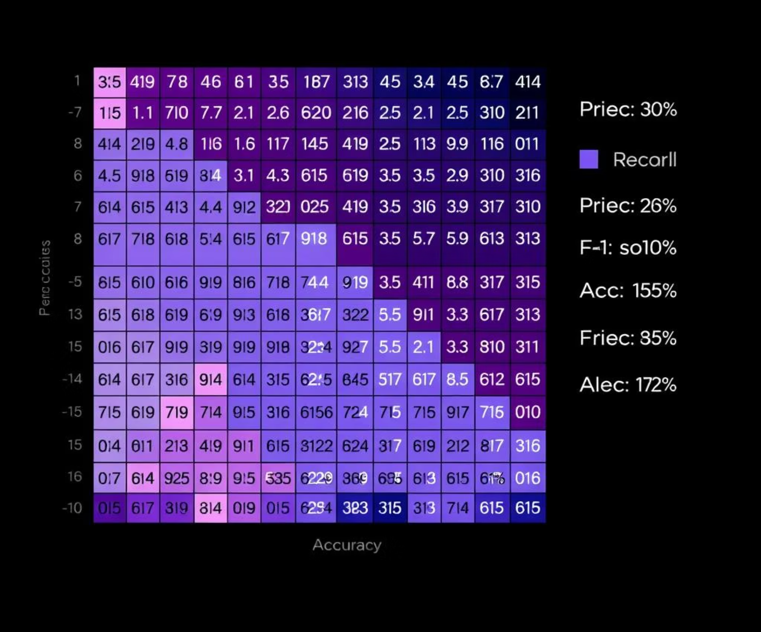
Random Forest Model Performance
Accuracy: 81% overall
F1-score (Class 1): 0.72
CONFUSION MATRIX
Recall: Strong for positive predictions
Precision: Balanced across classes

Slide 14
Key Predictors in Nutritional Guidance
Total Calories (kcal)
Fundamental determinant of dietary impact.
Total Fat (g)
Significant influence on caloric intake and health metrics.
Total Carbs (g)
Key energy source, impacting blood sugar and satiety.
Calories Expended
Activity level directly informs nutritional needs.
Persona Type
User-specific profiles drive tailored recommendations.

Slide 15
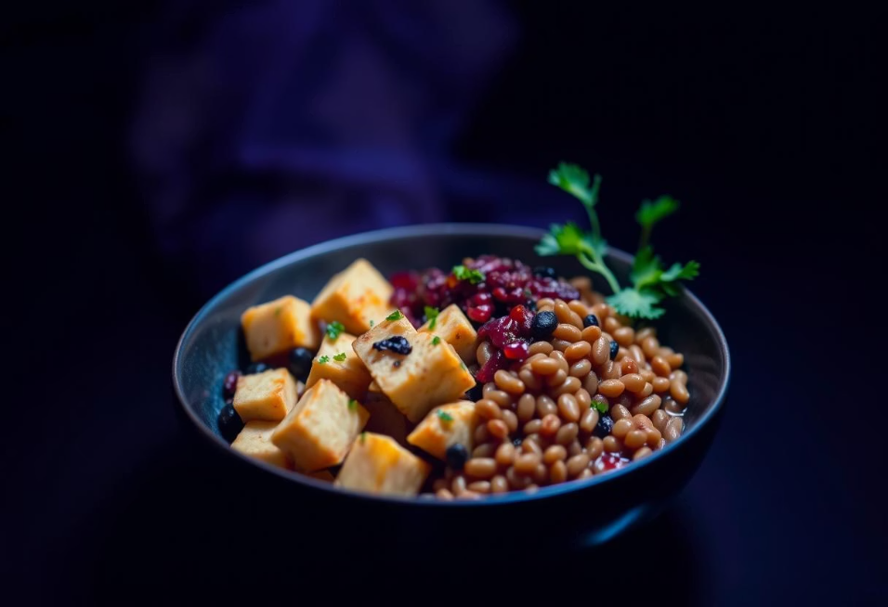
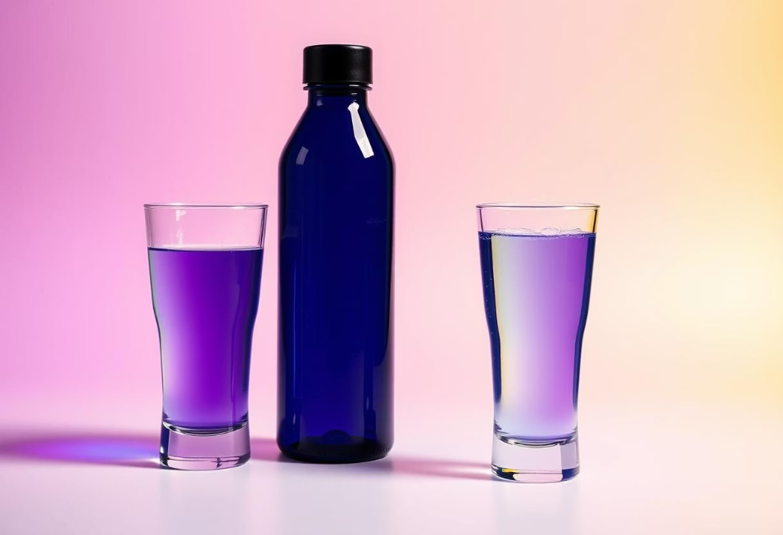
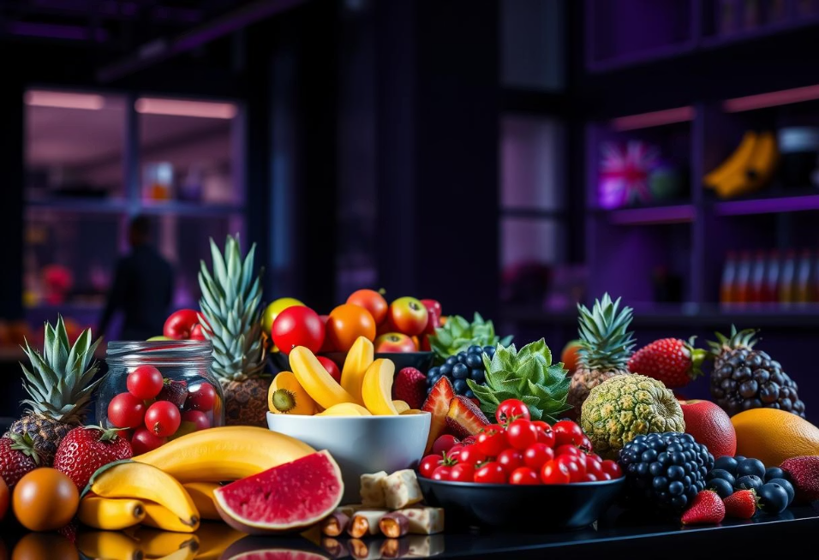
Intelligent Rule-Based Recommendations
Low Protein Intake
Insufficient Water Intake
Excessive Calorie Intake
Suggest plant-based alternatives like tofu, dal, or paneer.
Recommend consuming an additional 1-2 glasses of water.
Propose healthier, lower-calorie fruit options.

Slide 16



Synergistic Model Integration
ML Model Prediction
Rule Engine Application
Holistic Recommendation
Predicts the user's dietary goal achievement status.
Generates specific, actionable nutritional tips based on predicted status.
Combines predictive insights with practical advice for comprehensive guidance.

Slide 17
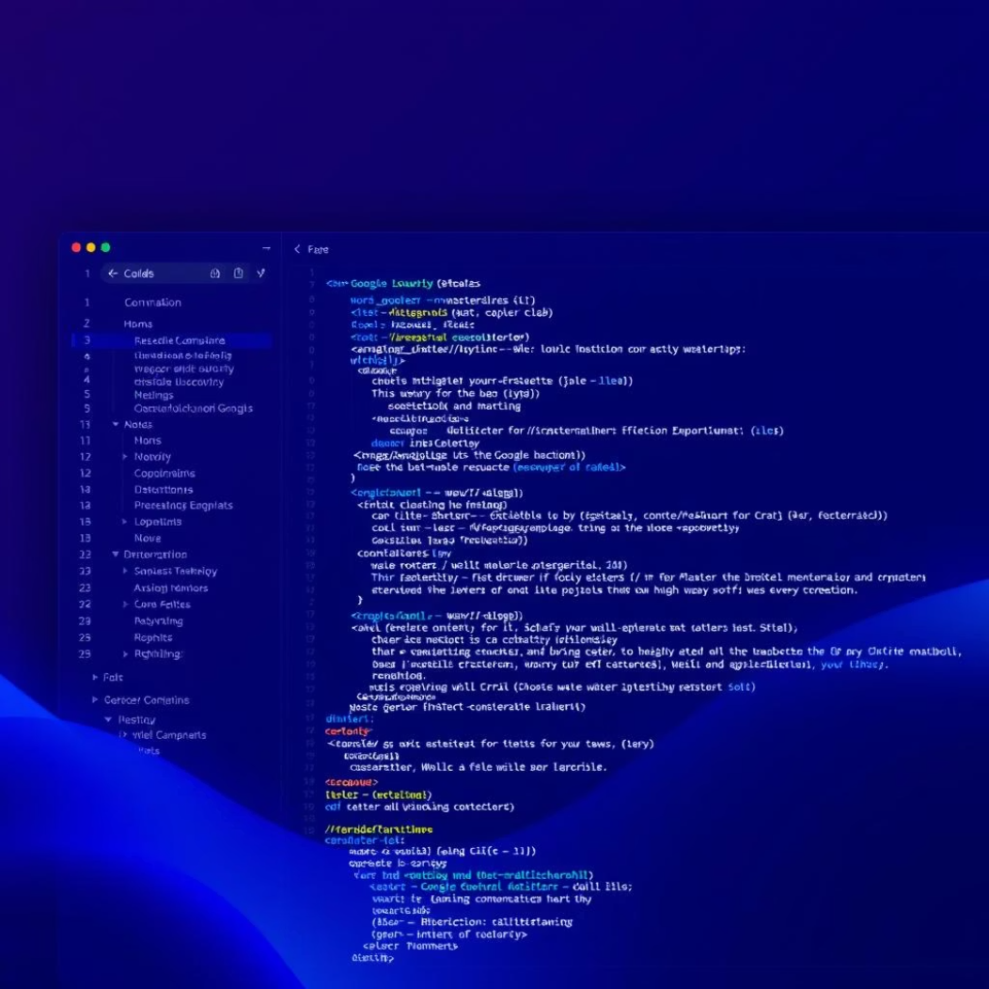
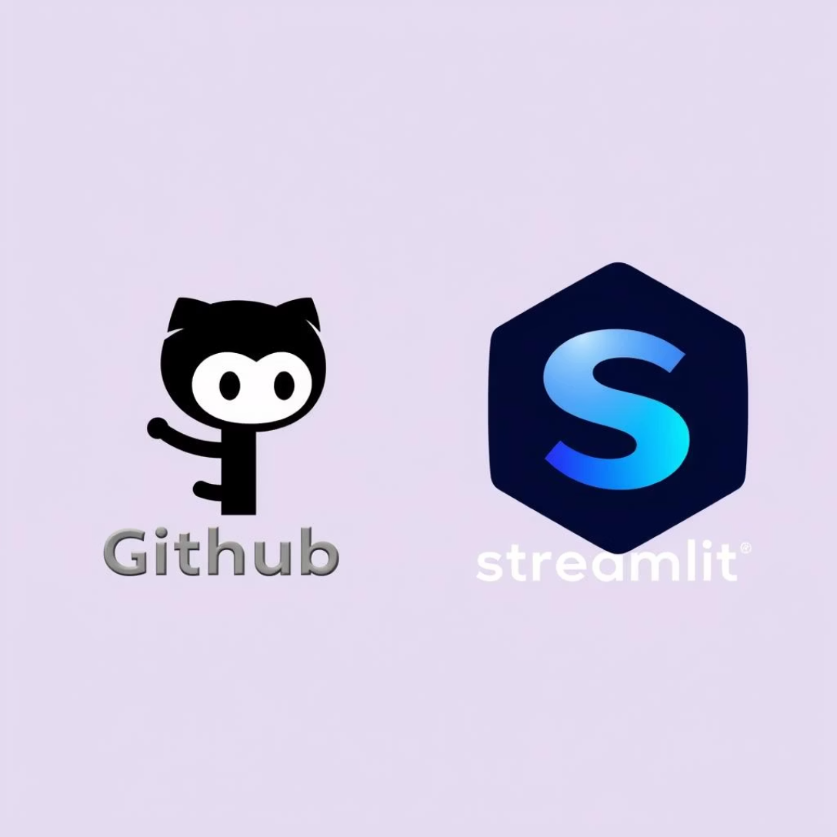

Development Environment & Tools
Google Colab
Python Ecosystem
GitHub & Streamlit
Primary platform for model development and experimentation.
Key libraries: Scikit-learn, Pandas, Matplotlib for data processing and visualization.
GitHub for version control; Streamlit for upcoming UI development.

Slide 18




Ethical AI Governance & Data Privacy
Synthetic Data
No PII Usage
All data used for training is fully synthesized, ensuring no real personal health information is processed.
Strict adherence to a policy of never collecting or utilizing personal health identifiers.
Medical Disclaimer
Inclusive Personas
Clear disclaimer stating NutriAI provides guidance, not medical advice.
Personas designed to be fair and representative, avoiding bias.

Slide 19
Overcoming Development Hurdles
Imbalanced Labels
1
Solution: Implemented SMOTE for synthetic minority oversampling.
Rule Conflicts
2
Solution: Extensive testing and iterative refinement of the rule-based engine.
Colab Performance
3
Solution: Modularized codebase to optimize resource utilization and reduce slowdowns.

Slide 20
Next Steps: Milestone III & Beyond
Streamlit UI: Develop an intuitive user interface for seamless interaction.
Adaptive Rule Engine: Enhance rules for dynamic, context-aware recommendations.
User Feedback: Implement mechanisms for collecting and integrating user insights.
Final Demo: Showcase the complete NutriAI system with a polished presentation.
Thank You!
Team – NutriAI Project. We look forward to your questions!

Slide 21
Thank You!
Team – NutriAI Project. We look forward to your questions!

